Slide 1
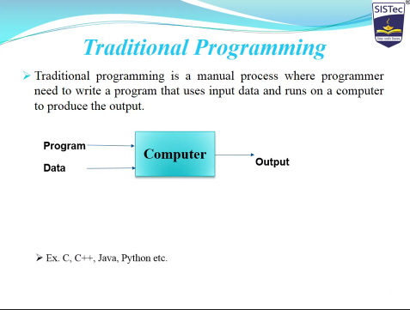

Slide 2
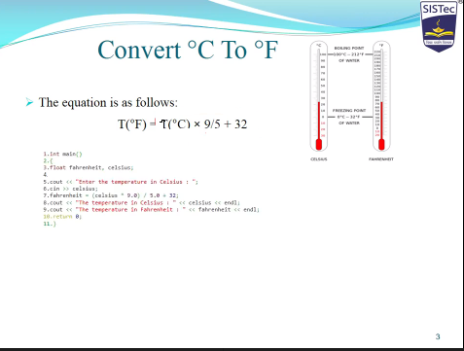
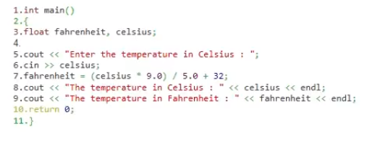
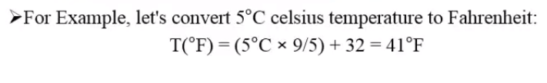
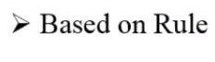

Slide 3

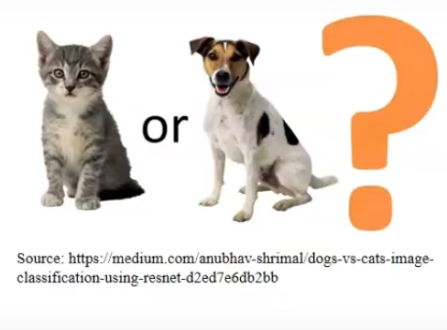
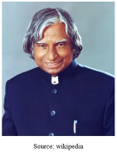
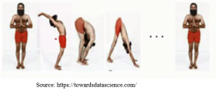

Slide 4
Artificial Intelligence vs Machine Learning vs Deep Learning
Artificial Intelligence
Machine Learning
Deep Learning

Slide 5
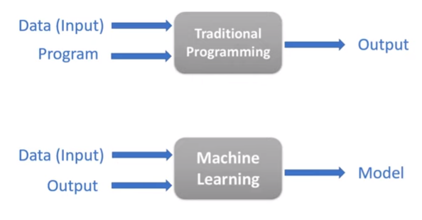
Traditional Programming vs Machine Learning

Slide 6
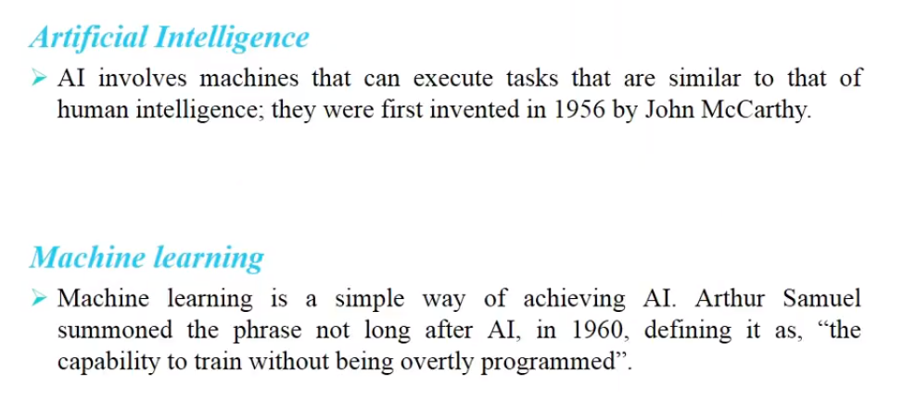

Slide 7
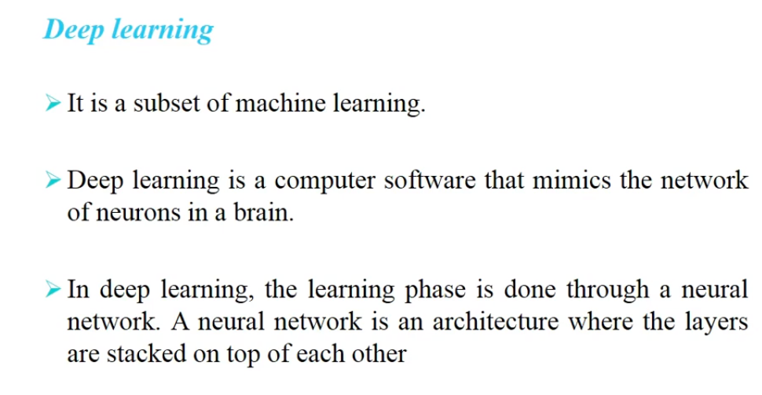

Slide 8
Artificial Intelligence
AI(Artificial Intelligence) is a subfield of computer Science
AI term was by Jone McCarthy in year 1956s
Artificial Intelligence ,term was meant to describe the goal that machines will be able to have humans like intelligence in future
Intelligence –”the ability to learn or understand or deal with new or trying situation”
Artificial Intelligence can be split two branches:
1. Applied AI(weak AI)
2. Generalized AI(strong Ai)

Slide 9
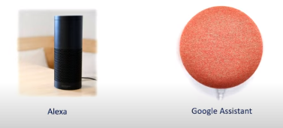
Artificial Intelligence
Applied Ai(week AI)-perform some specific tasks
2. Generalized AI(strong AI)-acts like humans

Slide 10
Machine Learning
Machine Learning is a subset of AI
Machine Learning is a set of algorithms that train on a data set to make prediction or take action in order to optimize some systems

Slide 11
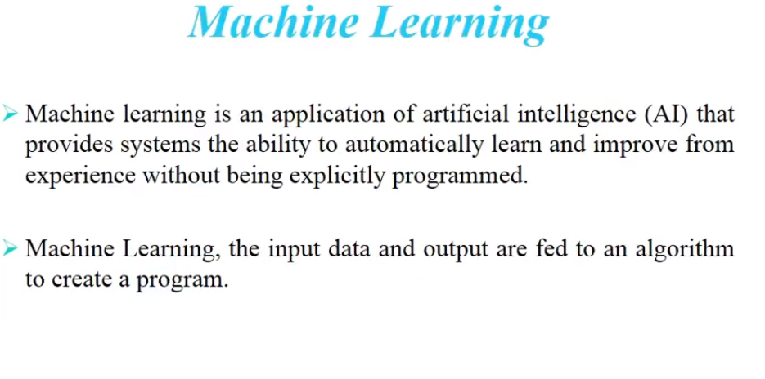
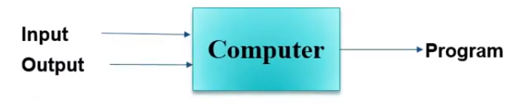

Slide 12
Deep Learning
Deep Learning is a next evaluation of machine learning
The term Deep learning was introduced to the machine learning community in 1986
Deep learning is a subset of machine Learning where learning method is based on data representation or feature learning
“Deep” refer to 1 or more hidden layers In this case

Slide 13
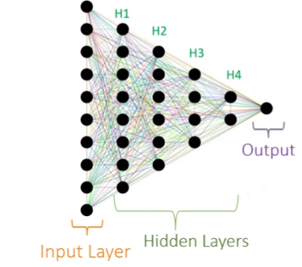
Deep Learning
In deep learning data goes through multiple numbers of non linear transformation obtain on output

Slide 14
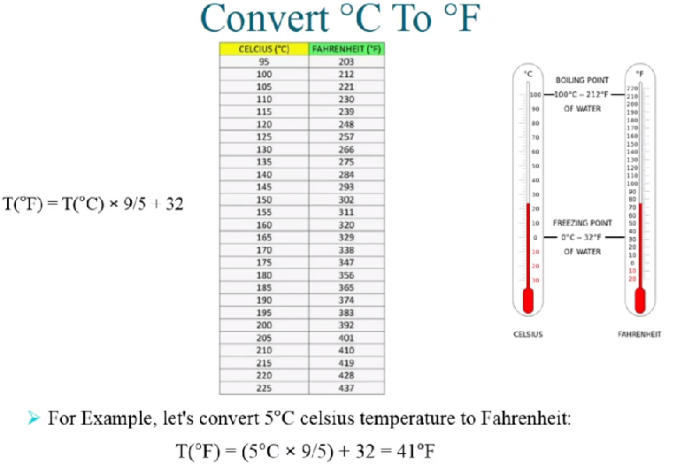

Slide 15
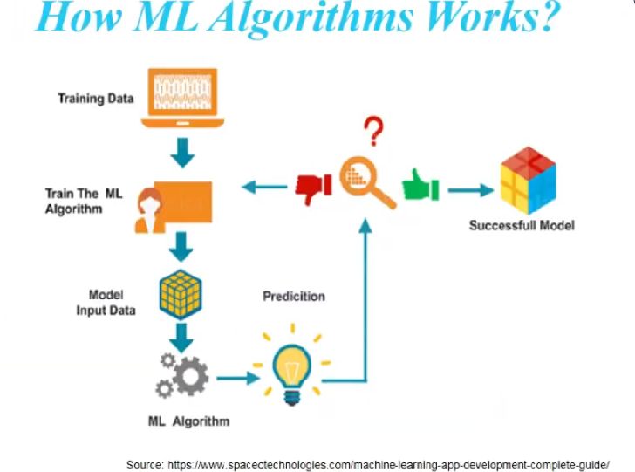

Slide 16
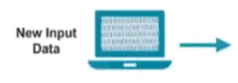

Slide 18
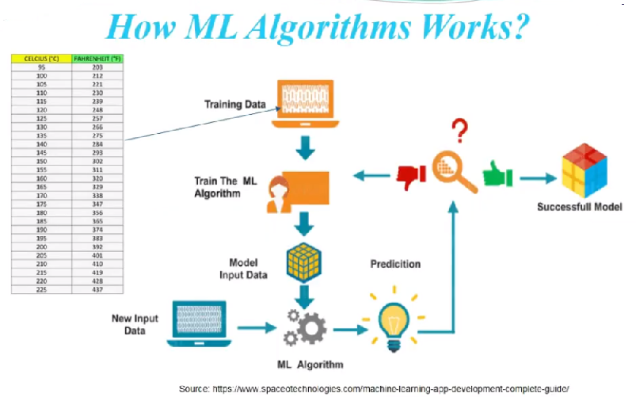


Slide 19
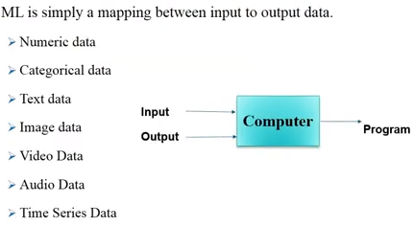
Type of data in ML

Slide 20
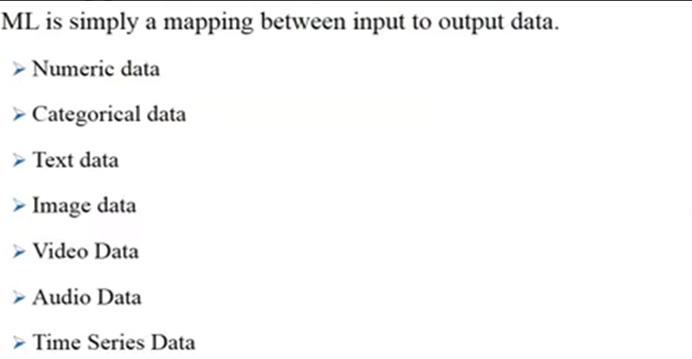
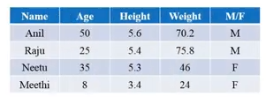
Type of data in ML

Slide 21
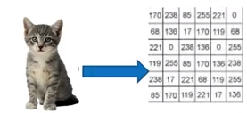
Type of Data in ML

Slide 22
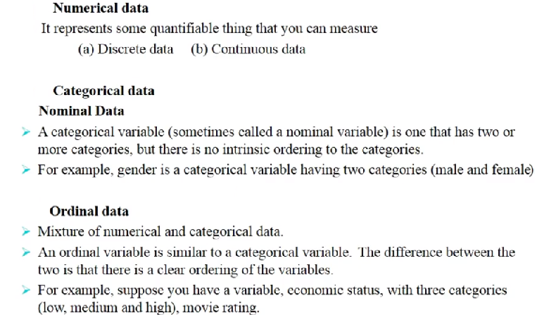
Type of Data

Slide 23
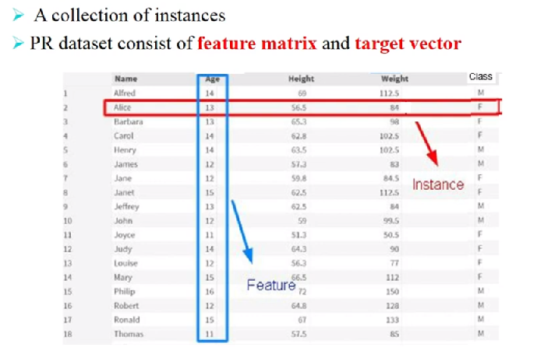
Data Sets

Slide 24
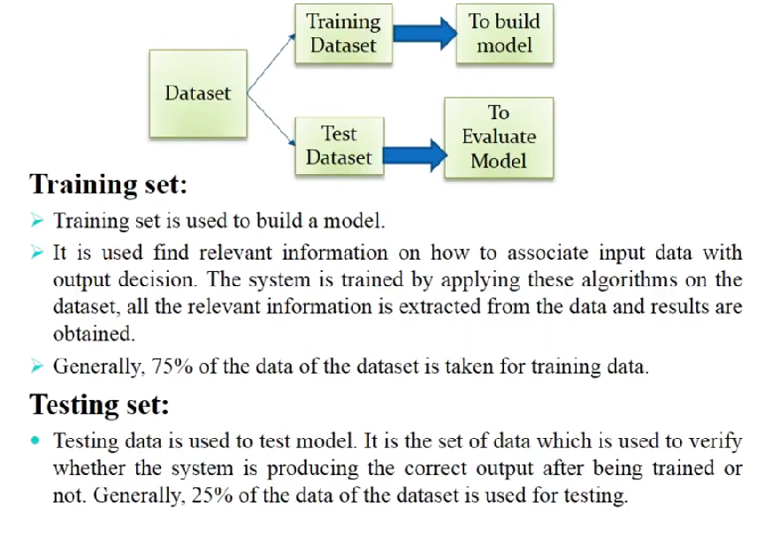

Slide 25
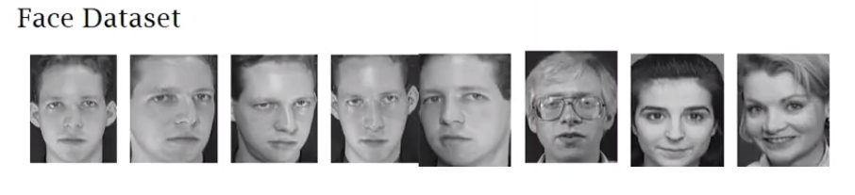
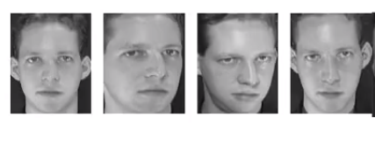
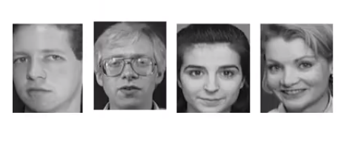
Face Reorganization Data set

Slide 26
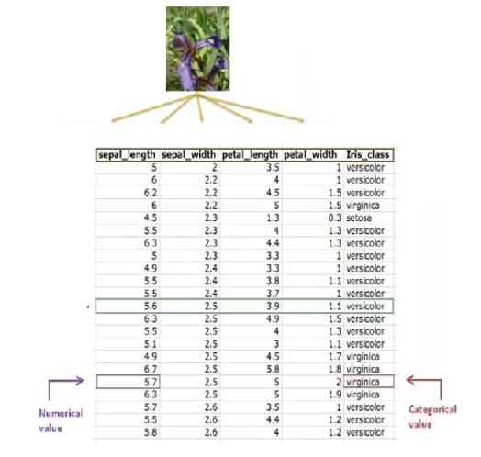
Iris DataSet

Slide 27
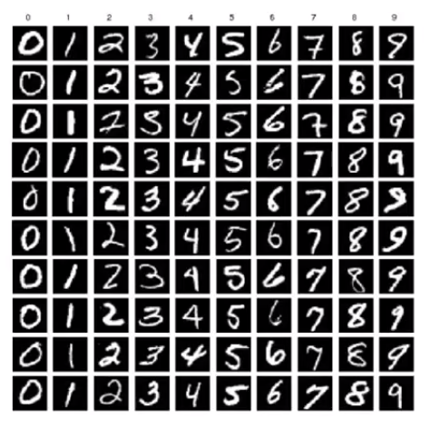
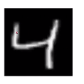
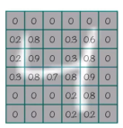
MNIST Dataset

Slide 28
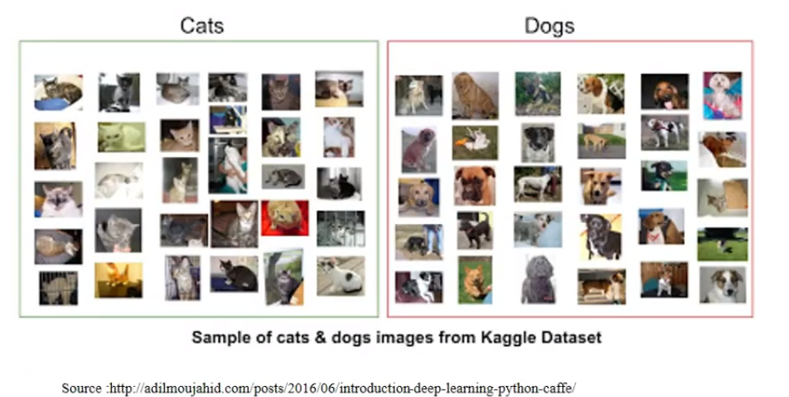
Cat-Dog Dataset

Slide 29
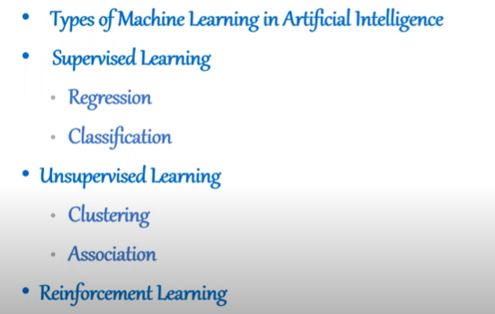

Slide 30
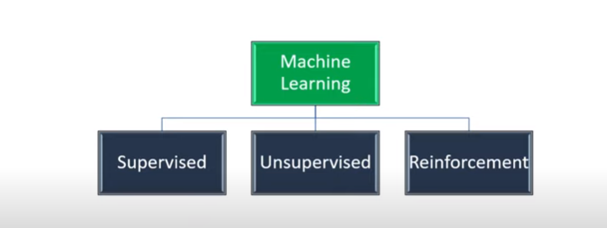

Slide 31
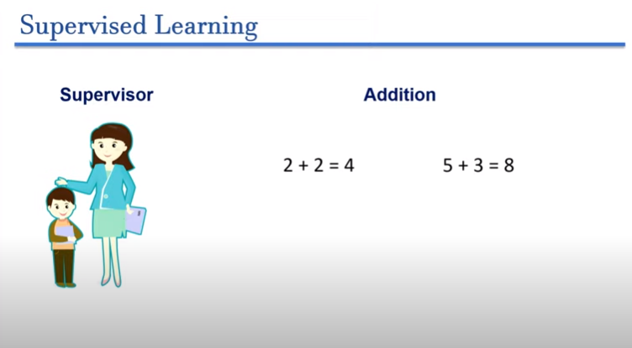

Slide 32
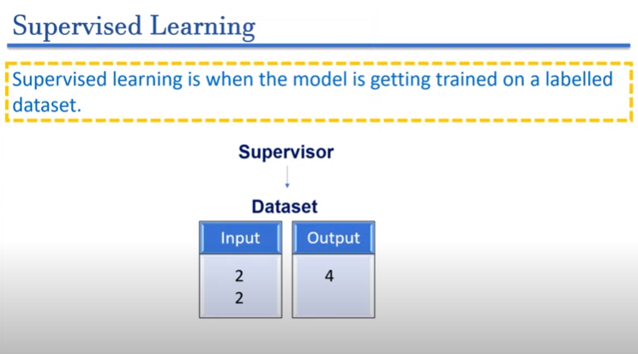

Slide 33
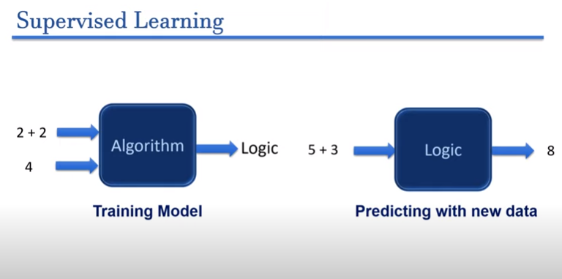

Slide 34
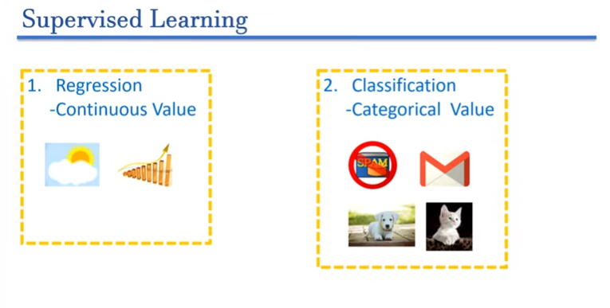

Slide 35
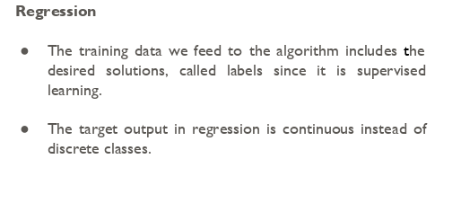
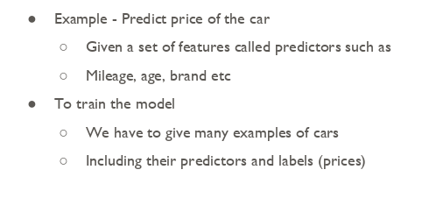

Slide 36
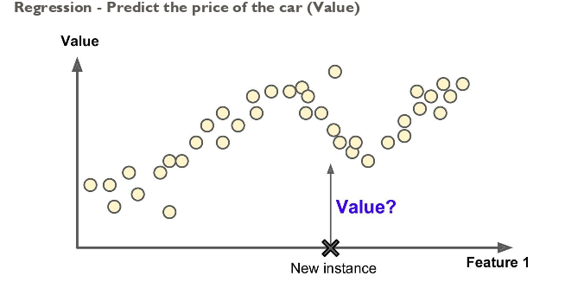

Slide 37
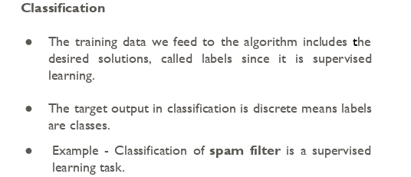

Slide 38
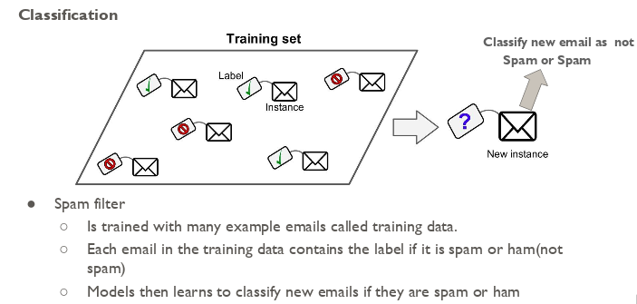

Slide 39
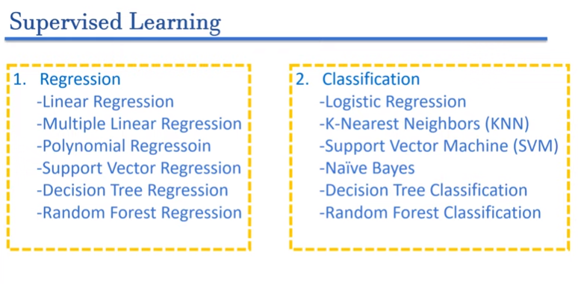

Slide 40
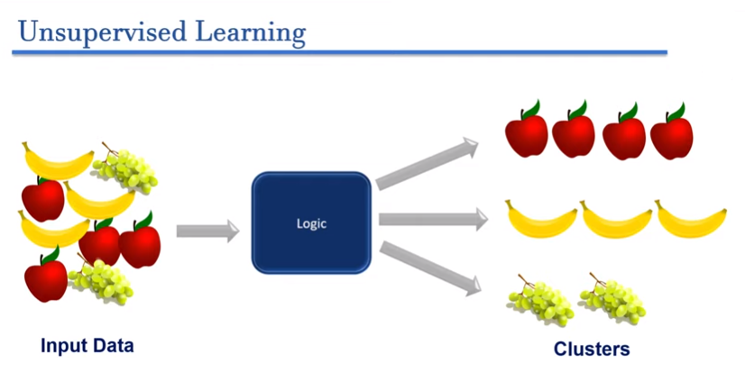


Slide 41
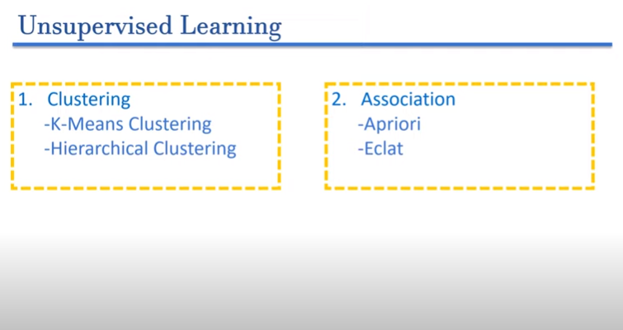

Slide 42
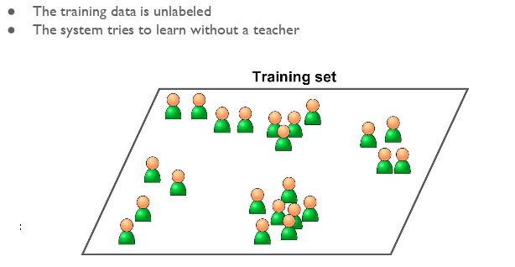

Slide 43
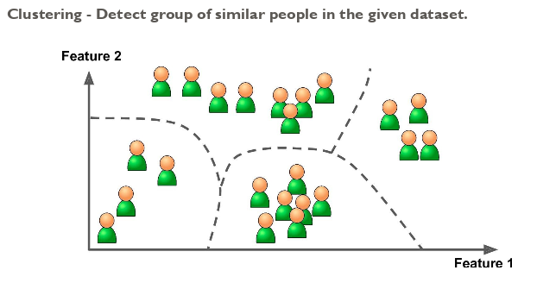

Slide 44



Slide 45


Slide 46


Slide 47




Slide 48



Slide 49


Slide 50


Slide 51



Regression

Slide 52


Regression

Slide 53

Regression

Slide 54

Regression

Slide 55

Evaluate the-Performance

Slide 56

Regression

Slide 57


Slide 58


Slide 59


Slide 60


Slide 61

Problem in R2

Slide 62


Adjusted R-squared

Slide 63


Regression

Slide 64


How to calculate coefficient

Slide 65


Slide 66




Slide 67



Slide 68


Slide 69


